Slide 1
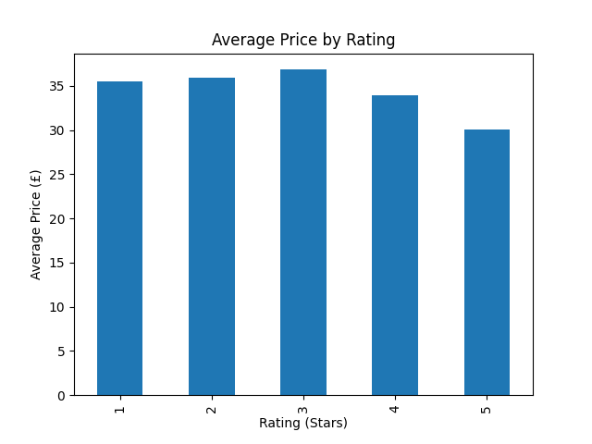
“Book Data Analytics Project — Python (BeautifulSoup + Pandas + Matplotlib)”
1st Data Analytics Project with AI By – Raj Bhirad

Slide 2
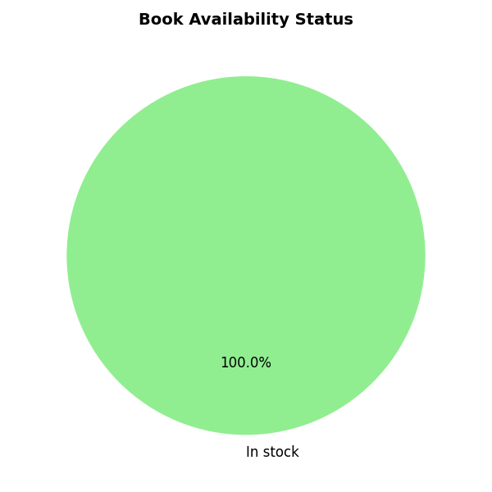

Slide 3
